Slide 1
STEPS IN IMAGE PROCESSING

Slide 2
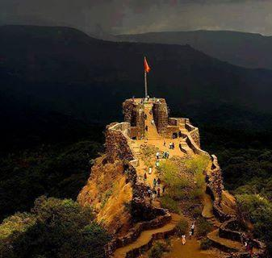
What is Image ?
An image is a spatial representation of a two dimensional or three dimensional scene.
An image is an array, or a matrix pixels (picture elements) arranged in columns and rows.

Slide 3
WHAT IS DIGITAL IMAGE PROCESSING?
DIP Definition: A Discipline in Which Both the Input and Output of a Process are Images.
Image
Process
Image

Slide 4
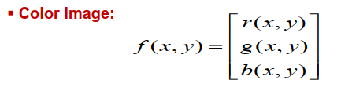
What Is Digital Image ?
An image may be defined as a two-dimensional function, f(x, y), where x and y are spatial (plane) coordinates, and the amplitude of f at any pair of coordinates (x,y) is called the intensity or gray level of the image at that point.  Digital Image: When x, y and the intensity values of f are all finite, discrete quantities, we call the image a digital image.
The field of digital image processing refers to processing digital images by means of a digital computer

Slide 5
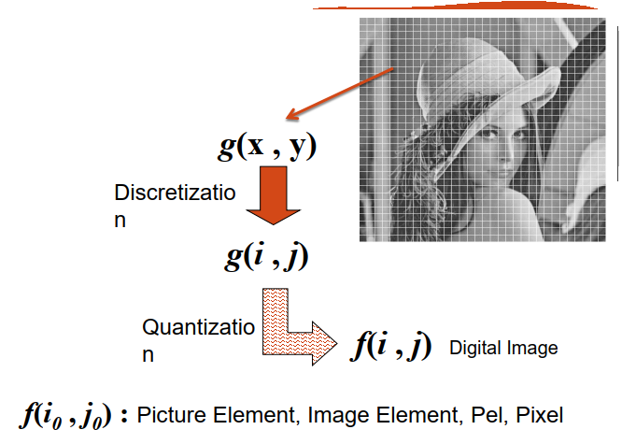
What Is Digital Image ?

Slide 6
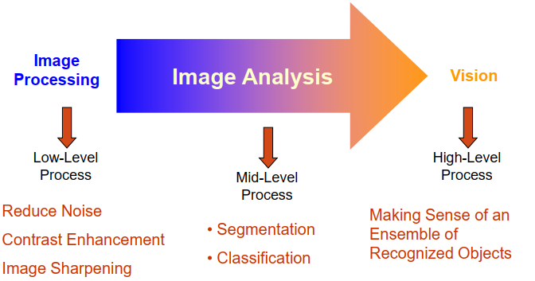
What Is Digital Image ?

Slide 7
Fundamental Steps in Digital Image Processing

Slide 8
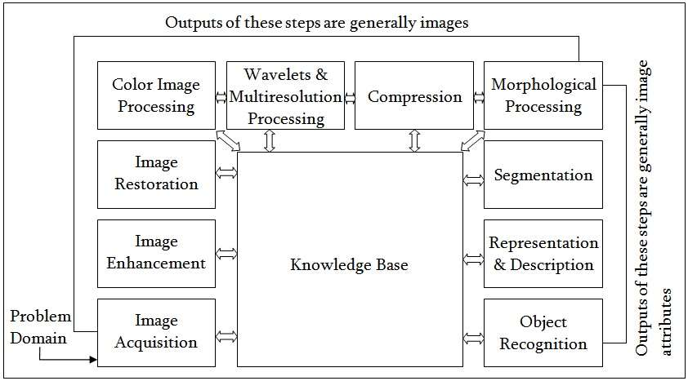
Fundamental Steps in Digital Image Processing

Slide 9
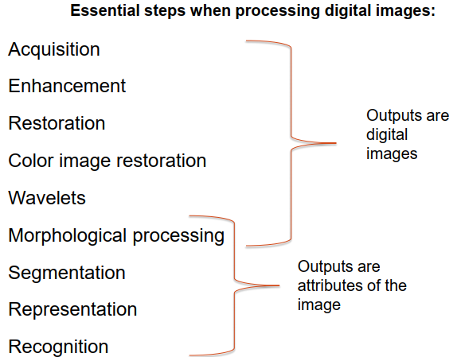
Fundamental Steps in Digital Image Processing

Slide 10
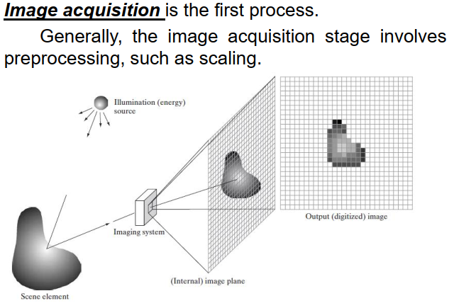
Image Acquisition

Slide 11
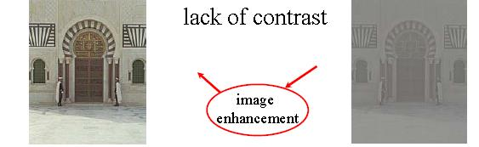
Image Enhancement
Image enhancement is the process of manipulating an image so that the result is more suitable than the original for a specific application. There is no general “theory” of image enhancement. When an image is processed for visual interpretation, the viewer is the ultimate judge of how well a particular method works.

Slide 12
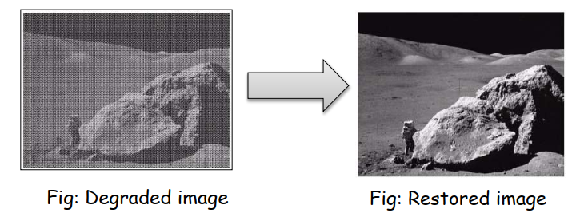
What is Image Restoration?
Image restoration attempts to restore images that have been degraded
Identify the degradation process and attempt to reverse it.
Almost Similar to image enhancement, but more objective.

Slide 13
Color Issue of an Image
Color Image Processing is an area that has been gaining in importance because of the significant increase in the use of digital images over the Internet.
• Red, Green and Blue Color cube • Consider Each element=8 bit • R,G,B ~0 to 255 • Grey scale f(x , y , L)
• 256 Grey shades • Color Scale f(x , y, r , g , b)-24 bit
255x255x255=16777216 colors

Slide 14
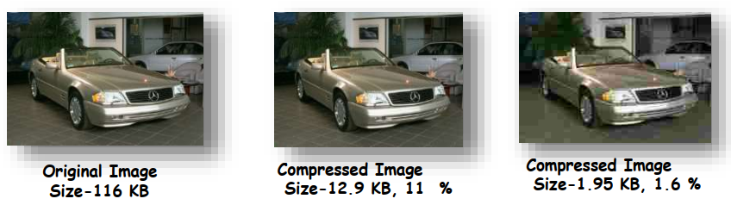
Image Compression?
• How we stored the image: Reduce the size for storage . • Compression-Remove redundancies. • Transmission with minimum bandwidth. • Lossy Compression=redundancy +some information, but still acceptable

Slide 15
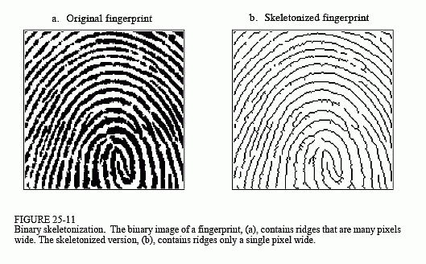
Morphological Image Processing
Extract image components that are useful in the representation and description of region shape, such as-
•Boundaries extraction •Skeletons •Convex hull •Morphological filtering •Thinning •Pruning…many More

Slide 16
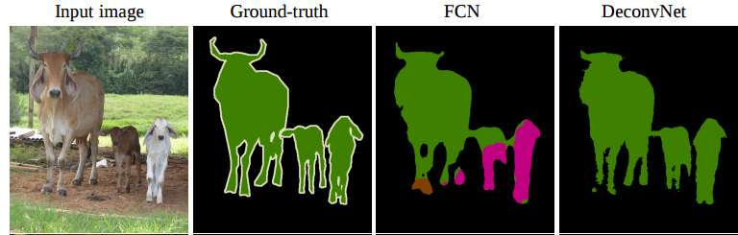
Image Segmentation
Image Segmentation is the process of partitioning a digital image into multiple segments. The goal of segmentation is to simplify and/or change the representation of an image into something that is more meaningful and easier to analyze

Slide 17
Image Representation & Description
• Image representation & description: After an image is segmented into regions; the resulting aggregate of segmented pixels is represented & described for further computer processing. • Representation and Description – Representing regions in 2 ways:
Based on their external characteristics (its boundary): – Shape characteristics
Based on their internal characteristics (its region): – Regional properties: color, texture, and …
Both

Slide 18
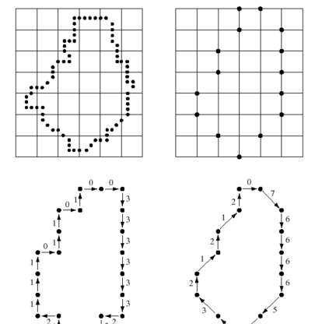
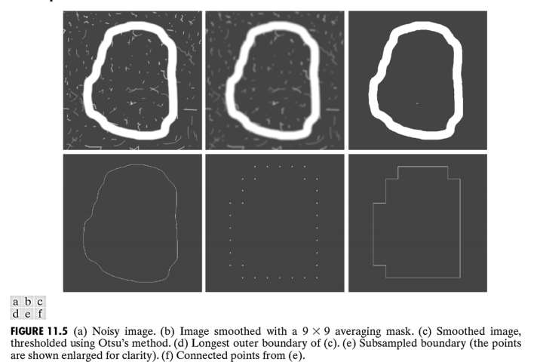
Image Representation & Description

Slide 19
Thank You

